Slide 1
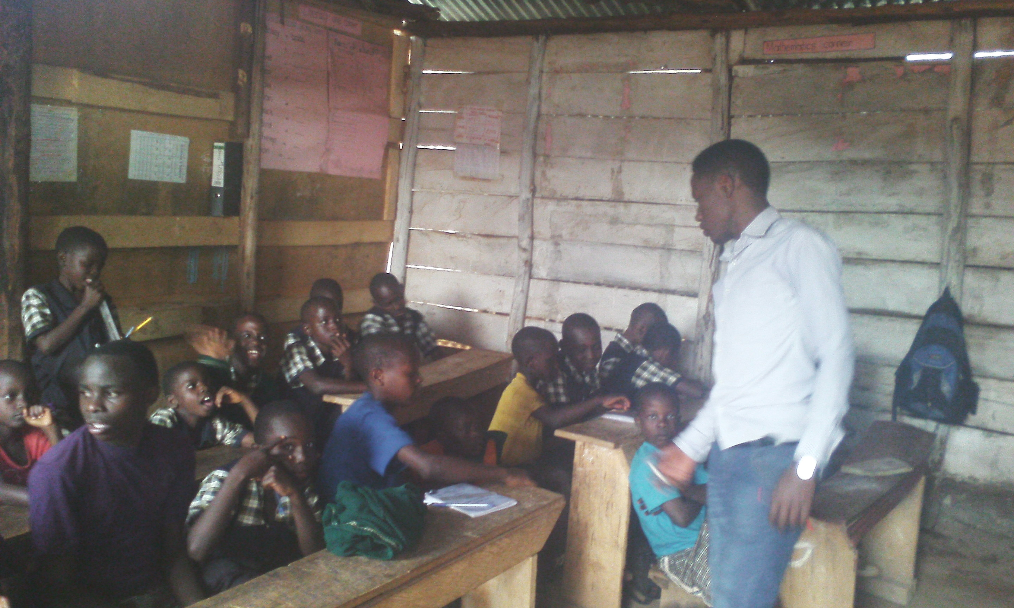

Bless a kid with education and skills
Give hope for tomorrow
Christian wasula

Slide 2
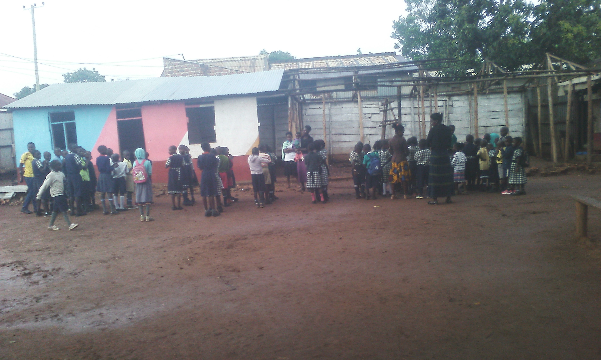

Vision
The vision for Blessed Hill Community Development Initiative(BHICODI):

Slide 3
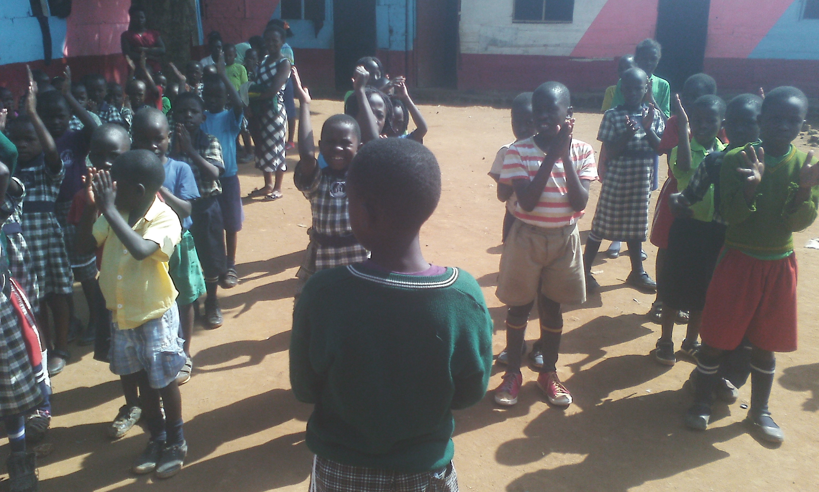
Mission & Goals
MISSION:
Equipping children with the Basic knowledge and Skills to fit in this Global World.
Goals of the Organization
To make the future helpers of the needy and vulnerable kids
To create a self sustainable lifestyle for the kids we are helping today
To have as many job makers as possible in the time to come

Slide 4
Objectives of the organisation
Teaching classwork and technical skills to the children
Giving counselling services to help these kids attain self confidence to make it in life
To avail the necessary tools and training team/services of ‘Hands on’ for children to learn practically as one way to sharpen their skills.

Slide 5
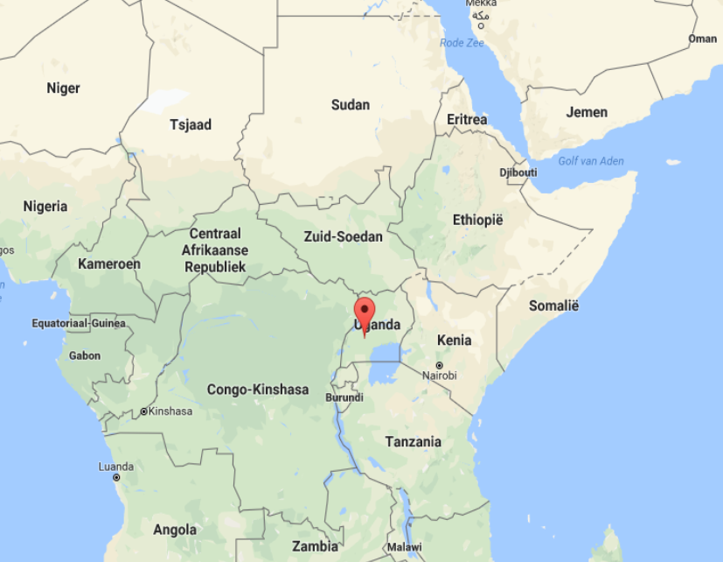
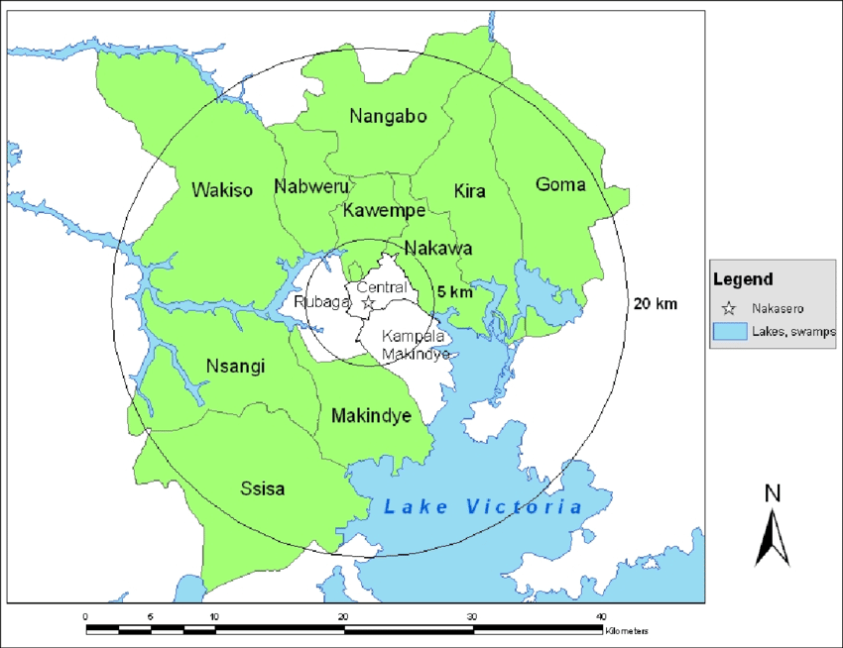
Area and Map Uganda - Kampala

Slide 6
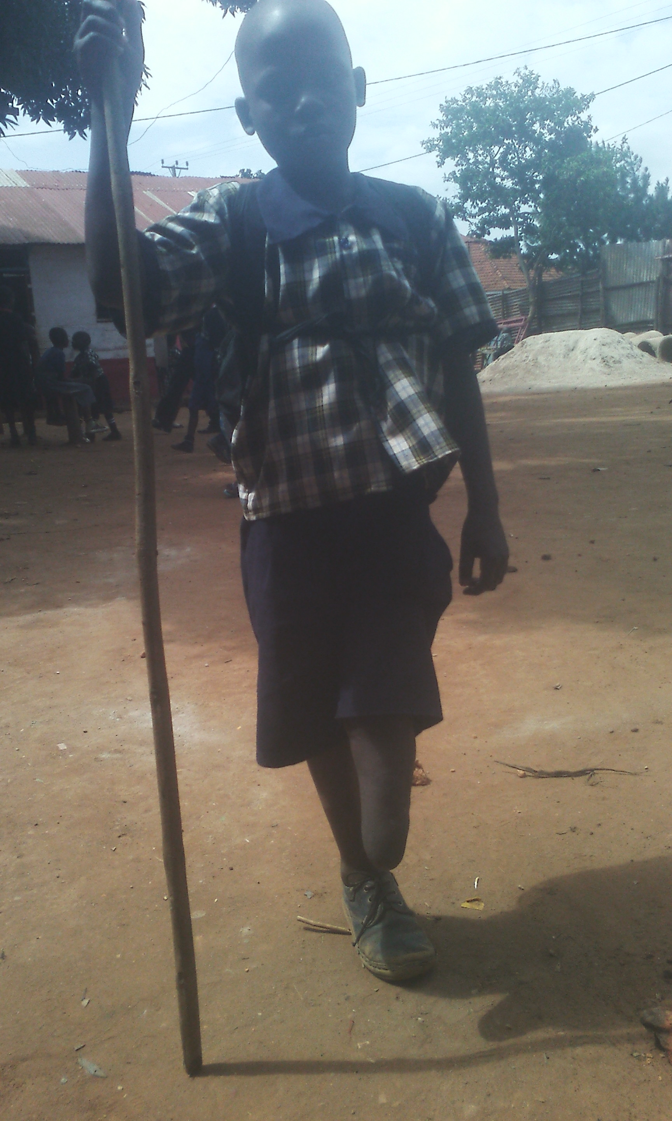
Project Activities
Teaching classwork
Training in technical/Vocational skills
Exploring and encouraging in born talents like music and sports
Giving counselling to the traumatized children and their caretakers
Giving access to medical care to the sick and troubled children
Creating development associations in the community like saving schemes
Encouraging the HIV/AIDS patients to take their ARVs to live longer

Slide 7
Budget to start – We are currently renting since 2015
Item | Description | EUR
Land | Hectare | € 3,333
Class room | Baby class up to Primary seven | € 11,111
Class room equipment | Tables, Chairs and desks | € 2,222
Toilet | Children/staff | € 3,222
Kitchen | Lunch | € 666
Kitchen equipment | Pans, dishes, utensils (children and staff | € 444
Office | Administration | € 1,555
Office equipment | Furniture, computer, printer, books | € 1,222
Uniforms | Shoes, sweater, shirts, shorts, dress | € 1,377.7
School equipment | Text books, note books, pens | € 666.6
Motorcycle | Visiting children | € 1000
Water | Plastic tanks (10,000 Ltrs) | € 288.9

Slide 8
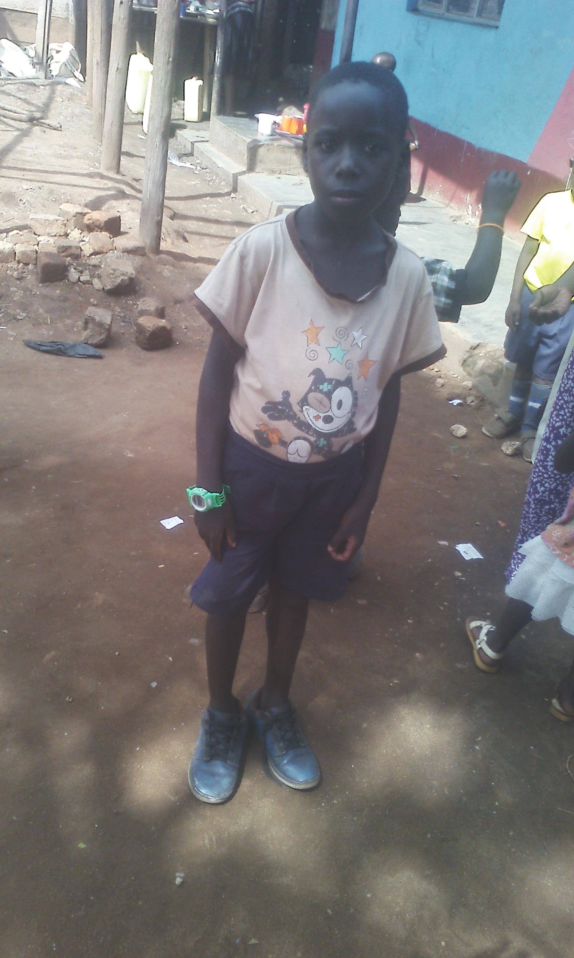
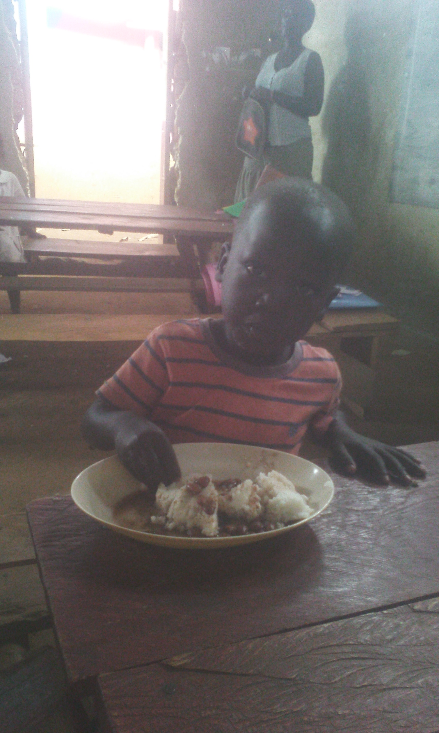
Realised and implemented
50 desks
6 children’s tables
Officedesk and 2 chairs
120 kids are learning
3 saucepans
140 plates for staff and kids
143 cups
13 staff members
Educate a child equip your tomorrow

Slide 9
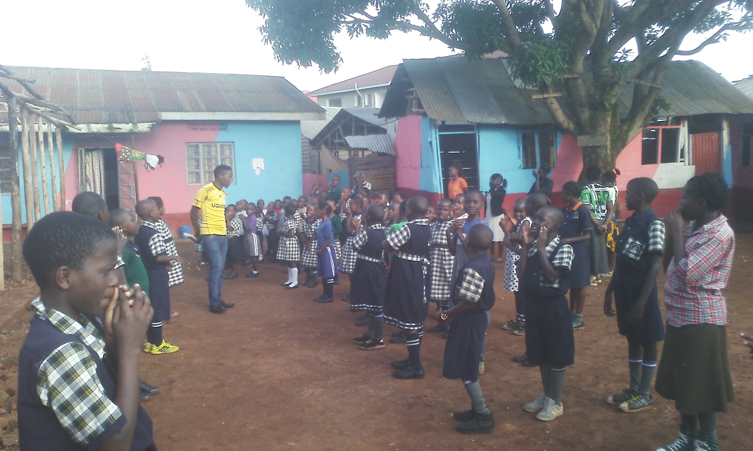

Slide 10
