Slide 1
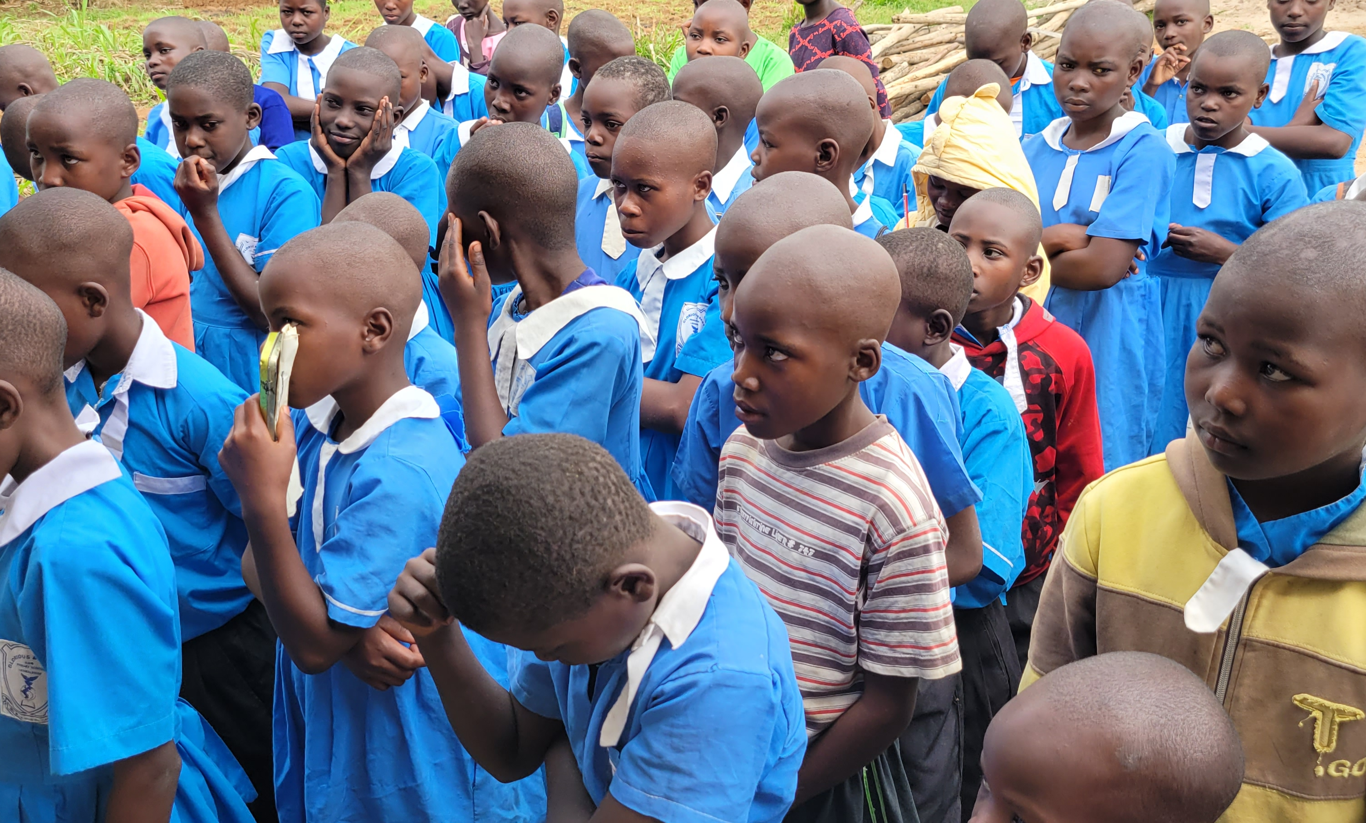
Building Hope, Changing lives
Helping Our Community Thrive
Glorious Primary and Nursery School

Slide 2
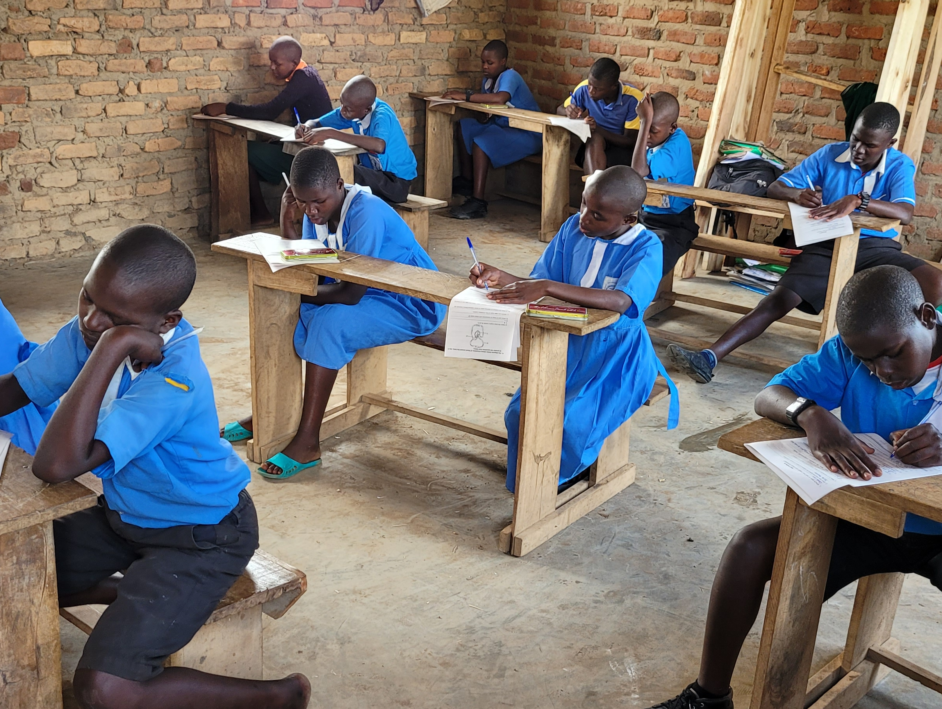
Humble Beginnings…. Our Story
Glorious Primary and Nursery School began in February, 2016.
With a dream of providing low-cost education to a hurting community, Jingo James, along with 7 volunteers, began a modest school in the village of Lwamalenge, in the Bukomansimbi District of Central Uganda.
Land was donated, a building was built, and so the project began!

Slide 3
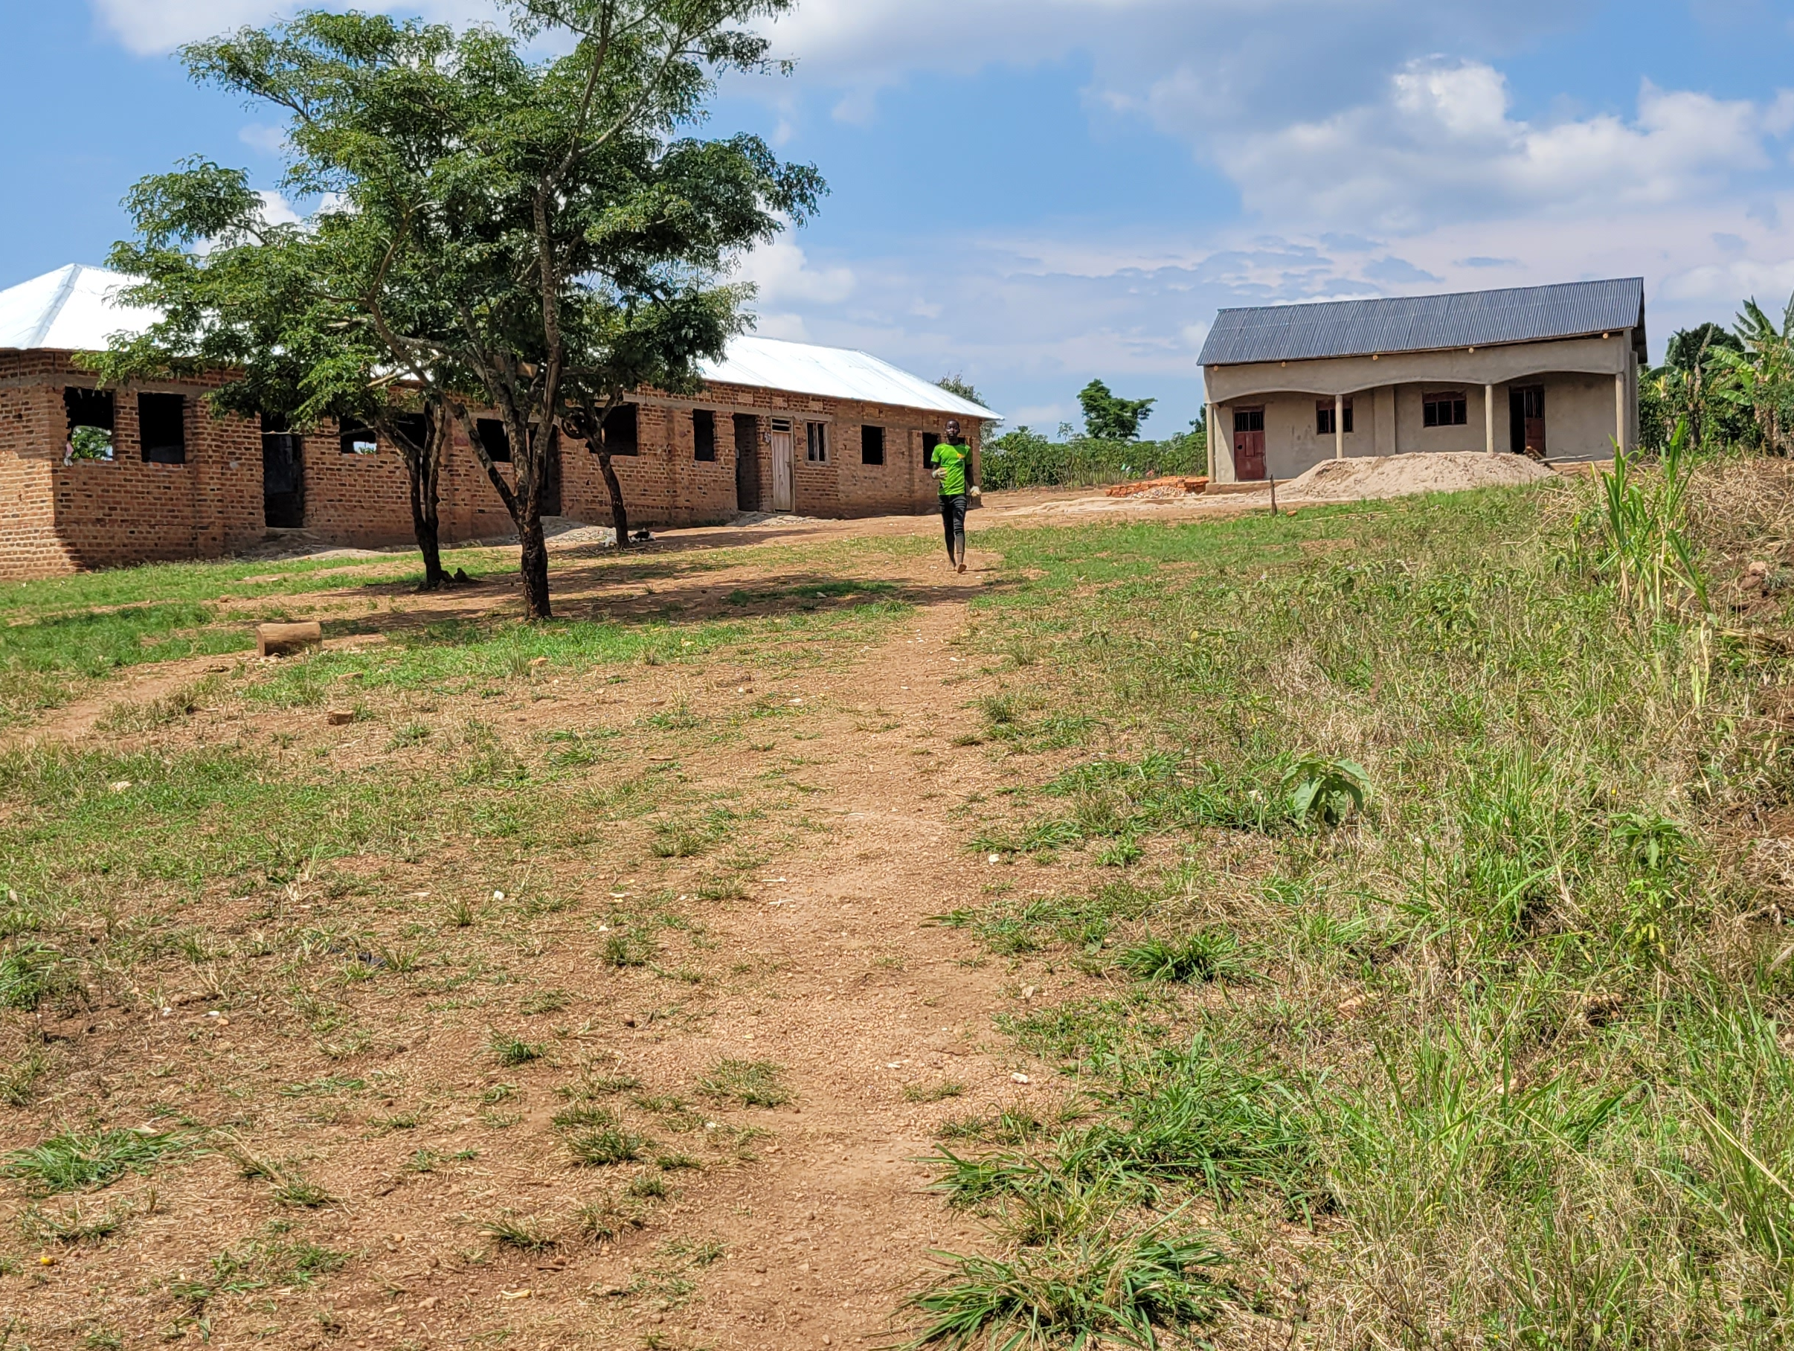
Our Vision is Glorious!
Our dream is to provide necessary education for the children of our community and hope for their families.
With education, opportunities and a vision for their future, entire families can break the cycle of poverty and have hope for a better tomorrow.
Utilizing knowledge, new skills, and a sense of hope, we are making a tremendous positive impact!
Glorious Primary & Nursery School

Slide 4
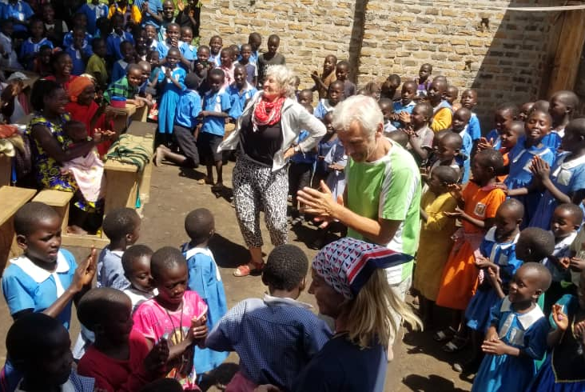
As Our School Grows
Our Needs also Increase
Glorious Primary & Nursery School continues to thrive, although most teachers work as volunteers, without pay.
We request that families provide food for their children to bring to school. However, 75% of the children arrive without basic provisions due to poverty.
The school endeavors to provide for these children as well as the teachers, relying largely on donations.

Slide 5
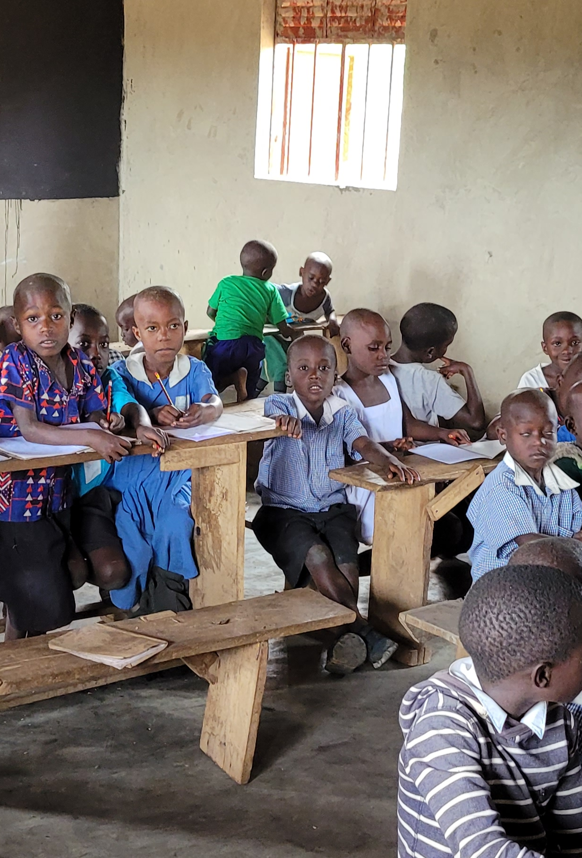
Glorious Primary and Nursery School Continues to grow every term!
Despite the odds, our school continues to prosper. New students apply to the school every term. Some come from distant villages to benefit from the service we provide.
Parents are seeing the difference in their children, and are expressing their hope and excitement for the school to continue. As children graduate to higher classes, we have a need to expand our levels upward.
Glorious Primary and Nursery School started with 40 children in February 2016 and ended our 2023Term with 350 children!

Slide 6
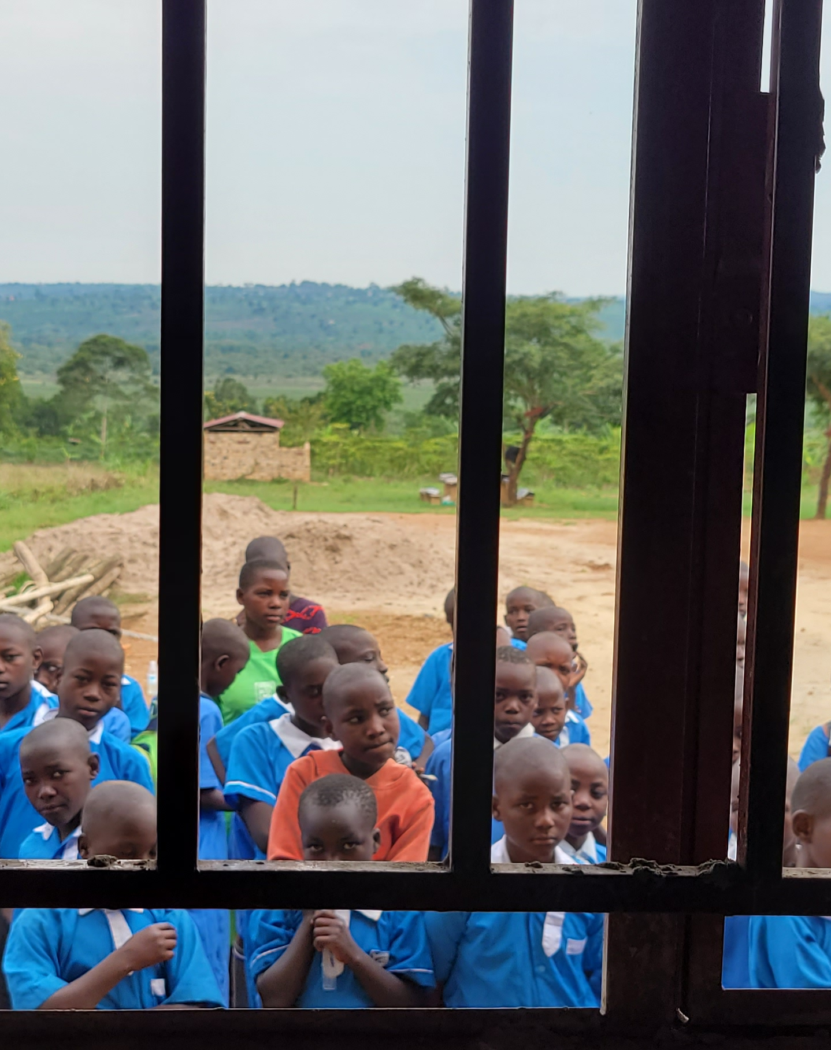
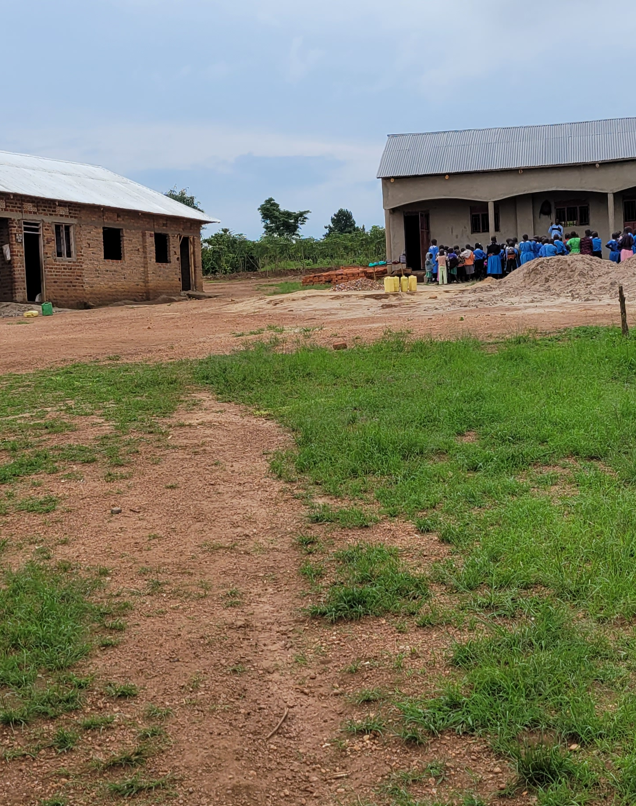
Mission & Goals
Our MISSION
Provide for the education needs of the village of Lwamalenge and surrounding areas
Our GOALS
Build fouer additionaclassrolooms
Build an assembly hall
Employ additional certified teachers
Purchase motorcycle in order to
  facilitate meetings with parents and community leaders
  make necessary purchases
  provide for emergencies
Purchase tables, desks and chairs for classrooms

Slide 7
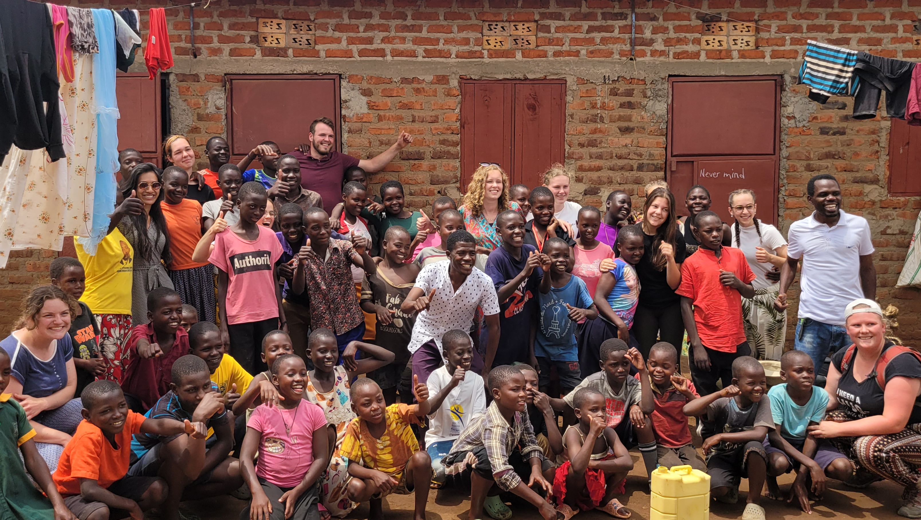
Our School’s
Objectives
Provide a classroom atmosphere that facilitates learning
Provide certified teachers
Provide meals for children that cannot afford to bring their own food
Provide for the needs of the students that are unable to return home on school breaks and weekends
Instill a sense of hope and purpose for every child; every child is a valuable and important part of our community.
Glorious Primary & Nursery School

Slide 8
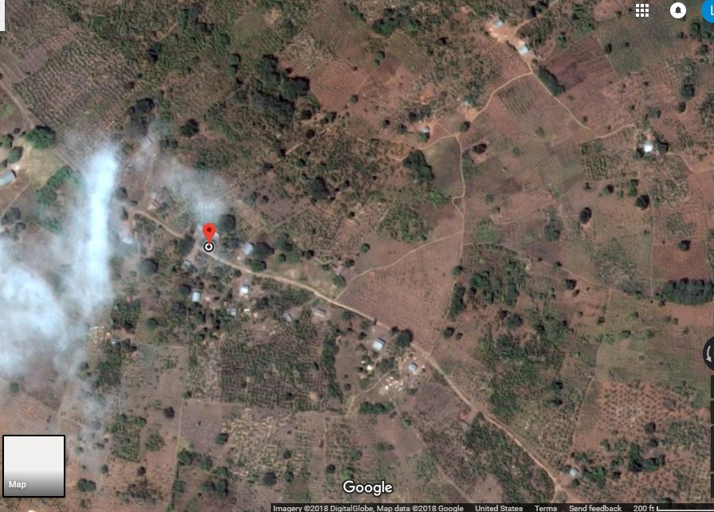
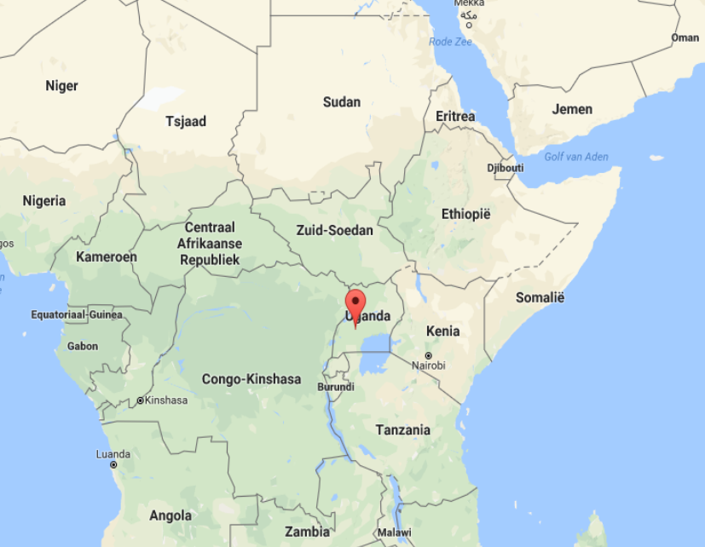
Lwamalenge Village, in the District of Bukomansimbi, Central UGANDA

Slide 9
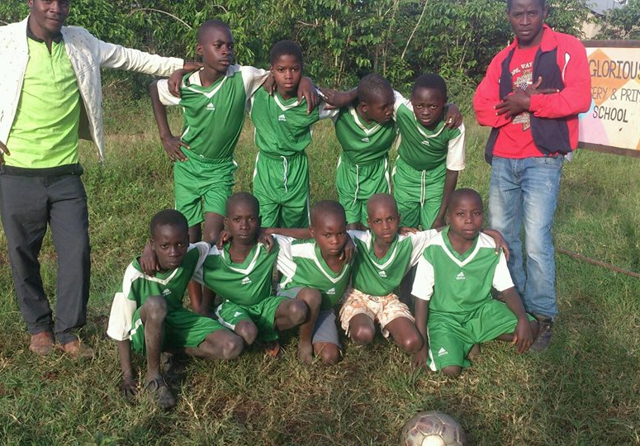
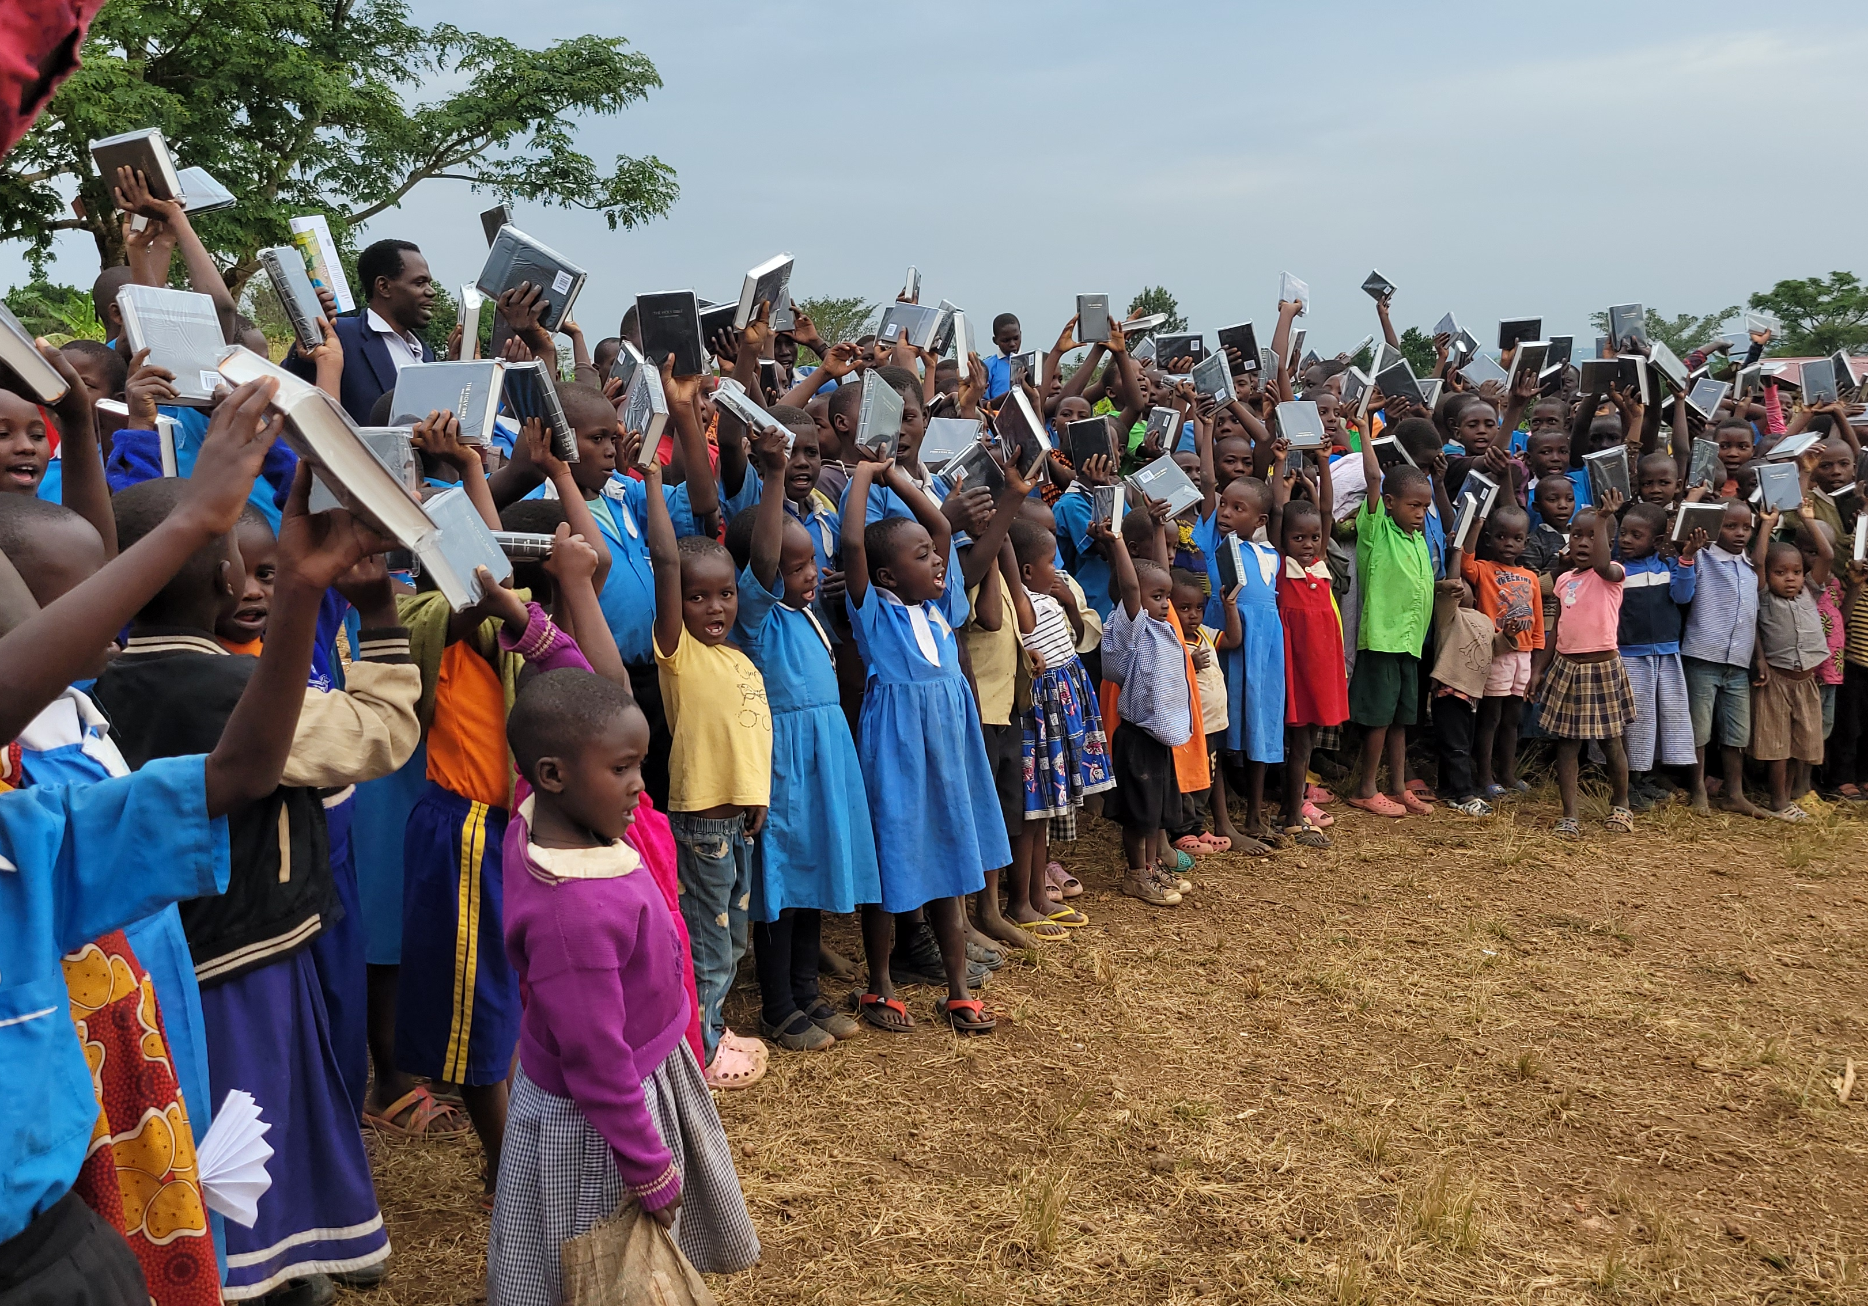
Project activities
Of Glorious Primary & Nursery School
Each class learns required subjects appropriate for their level in addition to developmental and social skills
Classes also engage in sports such as soccer, football and netball as well as field trips
Additional elective subjects are being added to provide cultural and trade skills which further enrich the lives of each child
Students enjoy mealtimes together and with their teachers

Slide 10
Current Goals & Budget to start
Item | Description | EUR
3 Classrooms | For levels P5, P6 & P7 | € 16000
Class room Equipment | Chairs and desks | € 2000
Office | Administration | € 10000
Office Equipment | Tables and Chairs | € 1000
Motorcycle | Transportation | € 1000
School Supplies | Text books | € 500
Kitchen | Preparation of meals | € 1000
Kitchen Supplies | Pans, plates, cups | € 700
Plastic Tank | Water storage | € 1500
License | Primary School | € 1000
Glorious Primary & Nursery School

Slide 11
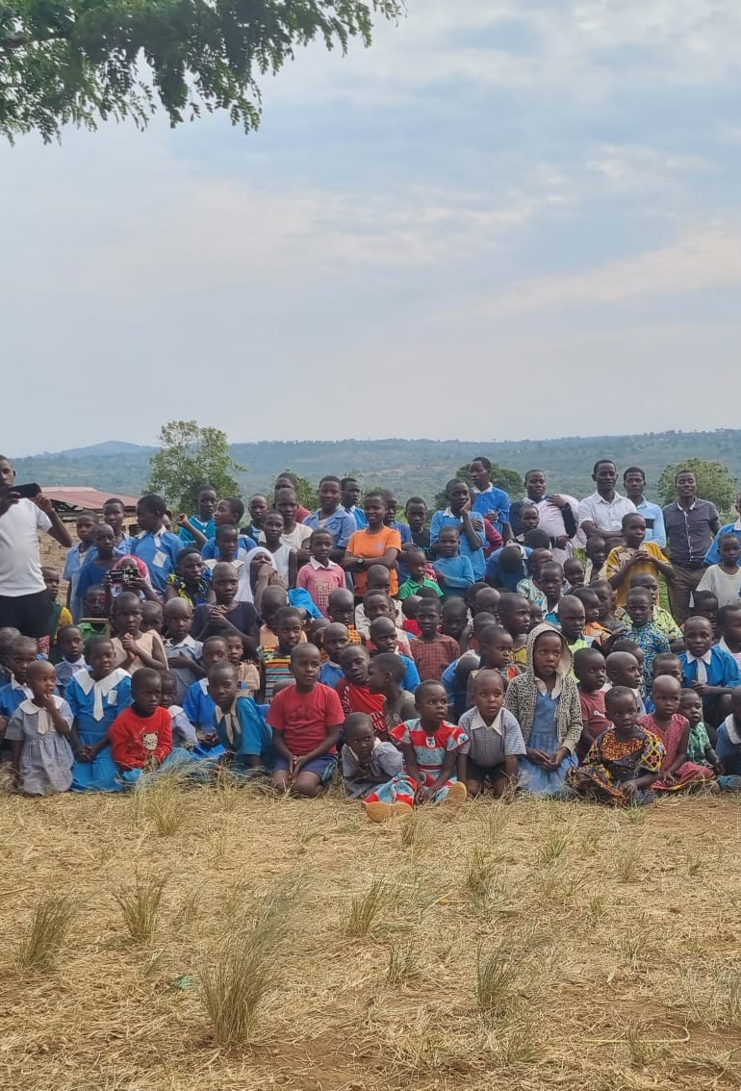
Realised and implemented from February 2016 through september 2023
Three quarters acres donated
five classrooms built on a new piece land and still enough land for exapansion
sixth and nineth classrooms built on onother piece of land
Toilets built, 2022
Additional land purchased (through donations) and five classrooms build on.
Land for agriculture rented for three years for food growth enough for teachers and children
Glorious Primary & Nursery School

Slide 12
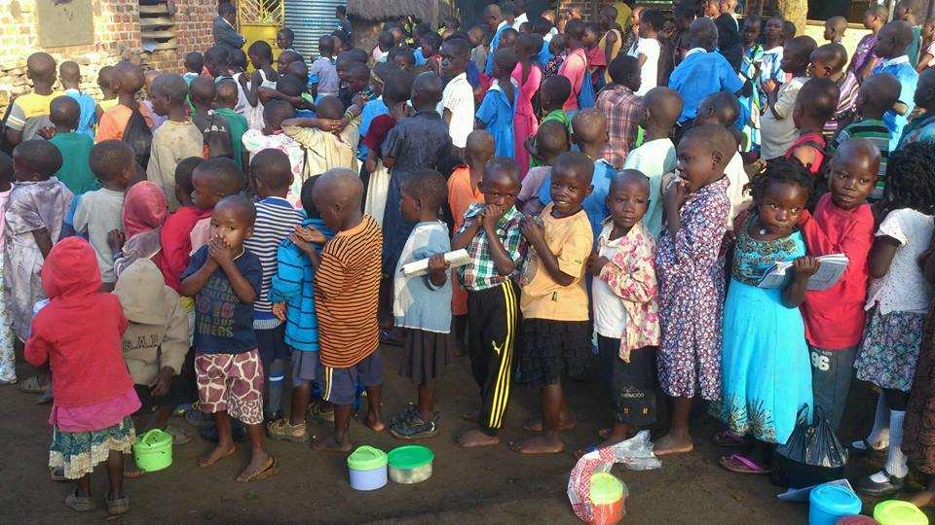
Glorious
Primary & Nursery School

