Slide 1
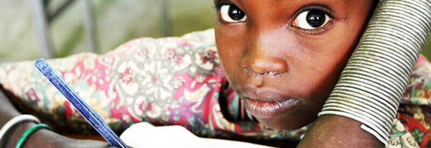

Inspire Children for the future
Giving hope for tomorrow
Rebecca Nabunya & Ambrose Kasiita

Slide 2
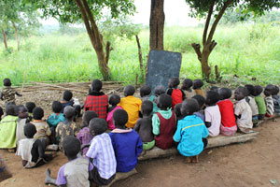
Vision
The Vision of Inspire Children for the Future is stated as:
Empowering the younger generation into becoming a healthy and fruitful Christians

Slide 3
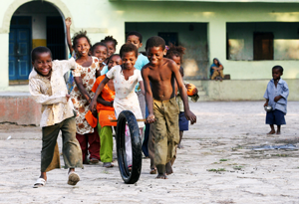
Mission & Goals
MISSION:
To equip the children in the Right way to become a solution to their peers, parents, communities and their Nation.
Goals of the Organization
To support children through education
Give hope to the hopeless – Vulnerable children
To develop children talents through imparted skills

Slide 4
Objectives of the organisation
The program intends to revive the hope of the Vulnerable Children in Kasambya community through these objectives;
to teach the practical skills and knowledge that will sustain the children to have self -reliance in future
to impart the sense of hard work and discipline for development of the body of Christ and their Mother Land Uganda
To spiritually, socially and economically empower the young people to make right decisions in their generations.

Slide 5
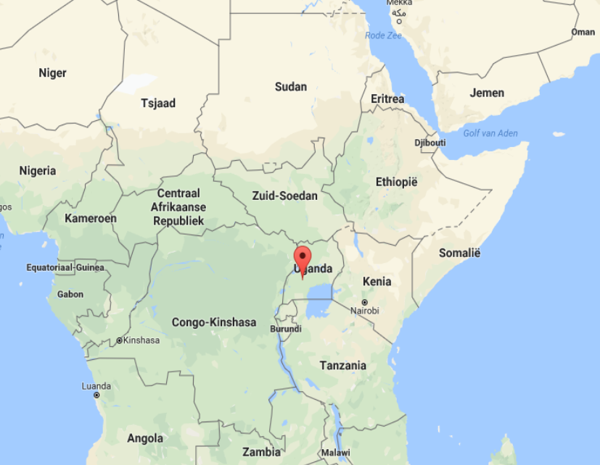
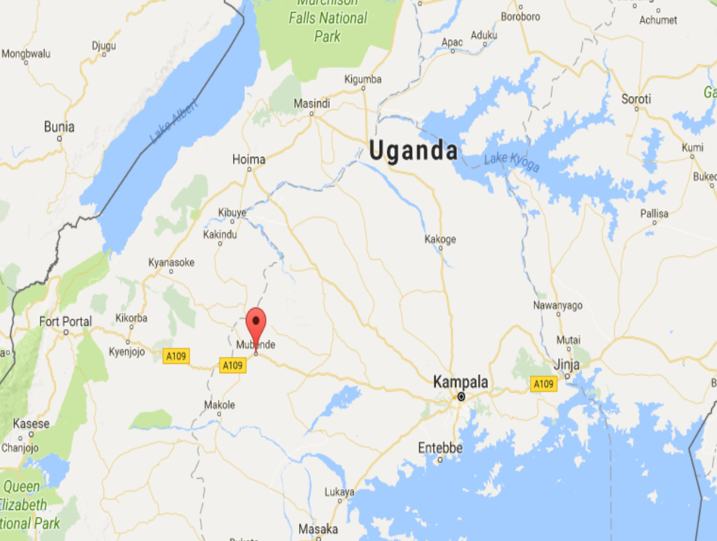
Area and Map Uganda & Mubende

Slide 6
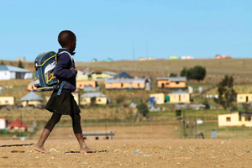
Project activities
Community mobilization and training
Children – sponsorship identification – Assessments
Visits to homes
Schools partnerships
Child advocacy and net working
Child protection and rights
Fund raisings
Planning and implementation

Slide 7
Budget to start
Item | Description | EUR
Land | Hectare | € 2.500
Class room | Baby class | € 2.500
Class room equipment | Tables, Charis | € 765
Toilet | Children/staff | € 1.000
Kitchen | Lunch | € 500
Kitchen equipment | Pans, dishes, utensils (childres/staff | € 480
Office | Administration | € 500
Office equipment | Furniture, comp., printer, books | € 1.000
Uniforms | Shoes, sweater, shirts, shorts, dress | € 625
School equipment | Text books, note books, pens | € 960
Motorcycle | Visiting children | € 1.000
Water | Plastic tanks | € 500

Slide 8
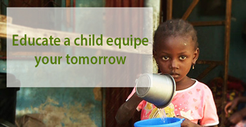
Realised and implemented
Inspired by God
Bought land in Mubende Uganda in 2016
Building organisation structure
Helping 10 children
Good relationship with local governement
Good communitation with local parents
Found individual sponsors all over the world
Received support, experience and knowlegde from senior directors of Children Sure House
Build website (www.inspirechildren.net)

Slide 9
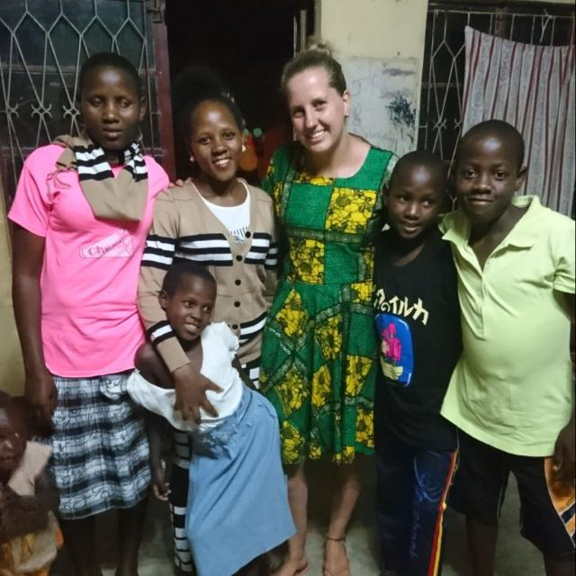
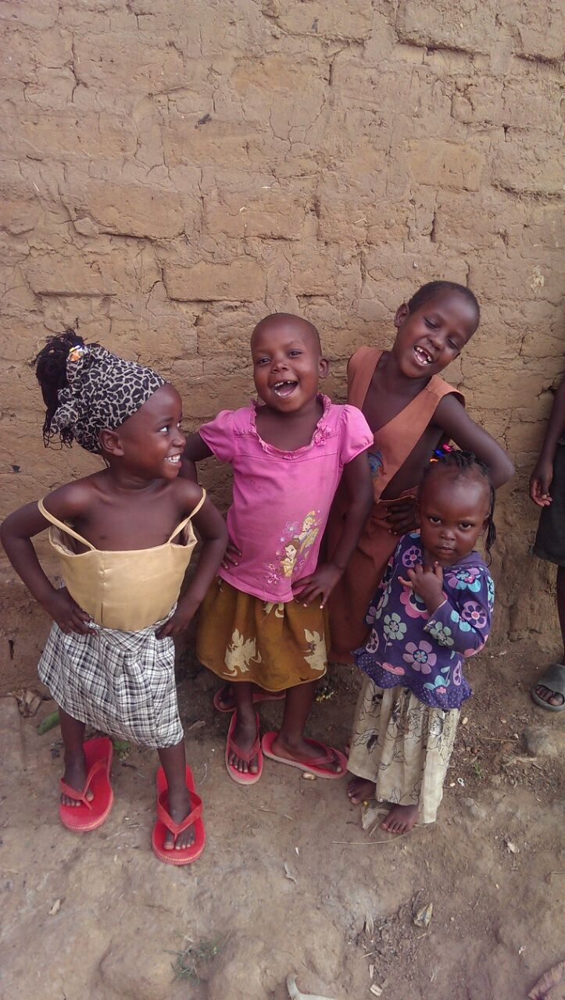

Slide 10
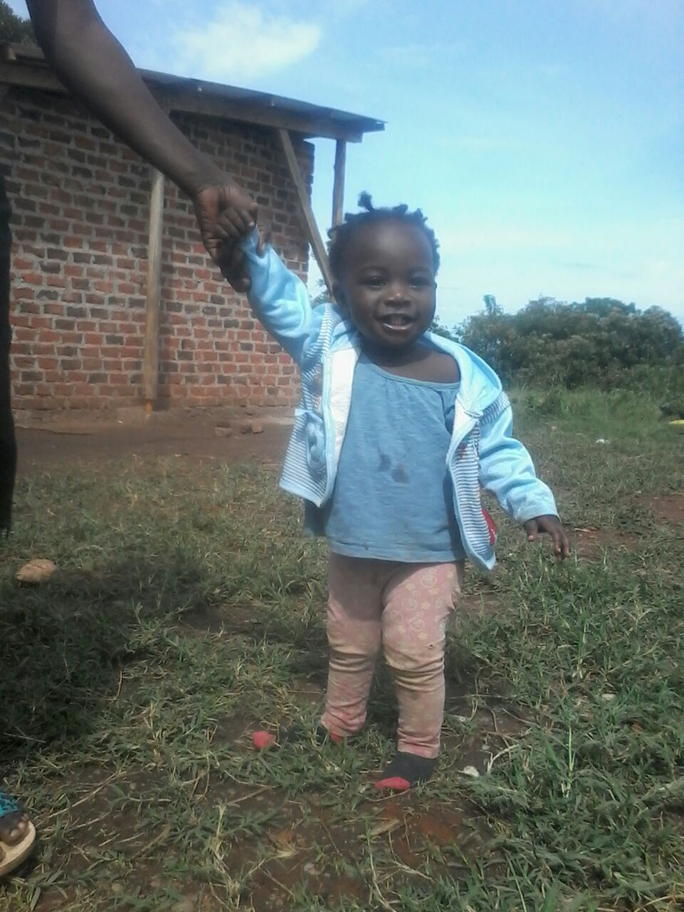
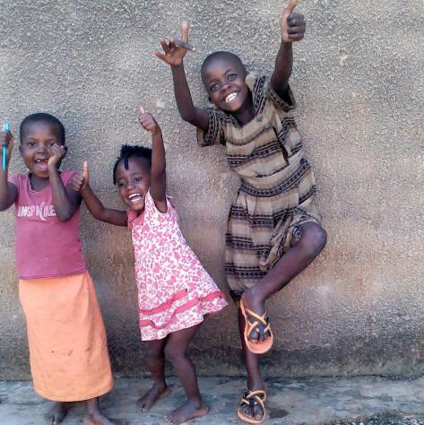
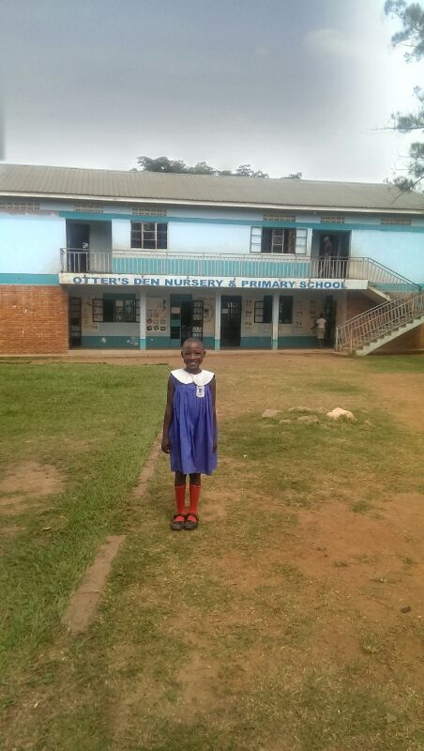

Slide 11


