Slide 1
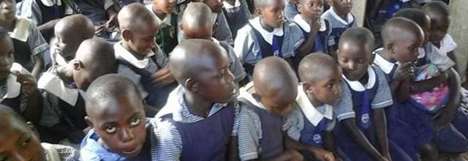

Children's solution ministries
"Enabling the future of vulnerable children "
Harriet Nayiga and Richard Rukundo
www.childrensolutionministry.com

Slide 2
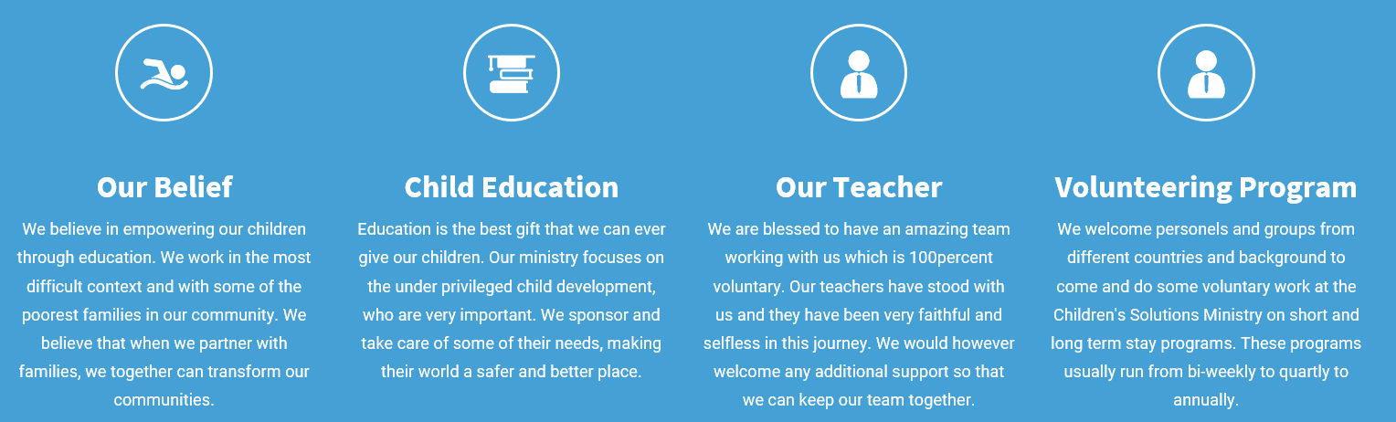
Vision
Physically, Spiritually and morally transformed people.
“Children are a blessing from God and they are an inheritance that God gave us. Give a child education and you will have solved half of Africa's Problems”

Slide 3
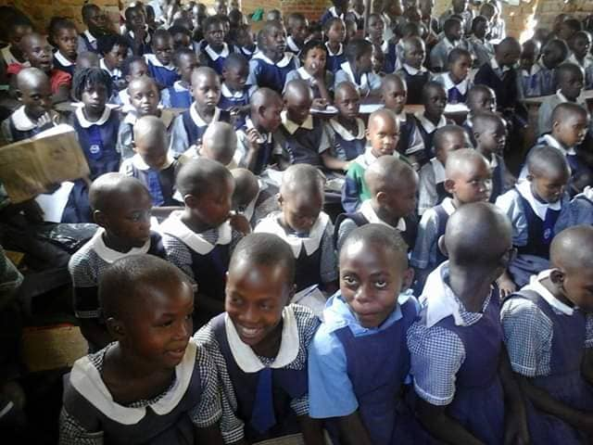
Mission & Goals
MISSION:
To enable the future of vulnerable, unprivileged, needy and orphan children.
Goals of the Organization:
To provide quality formal education.
To promote children's talents .
To outreach communities for Christ.
To sensitize children about HIV/AIDS.
To sensitize children how to preserve the environment.
www.childrensolutionministry.comc

Slide 4
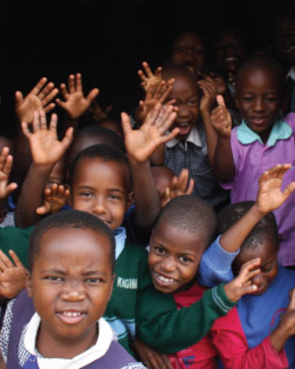
Objectives of the organisation
Establish schools to provide formal education to children.
To establish churches where there is a need.
To identify children's gifts and talents and help to develop them.
To provide food security through modern farming.
To provide guiding and counseling to the youth.
To provide shelter to the homeless children.
www.childrensolutionministry.com

Slide 5
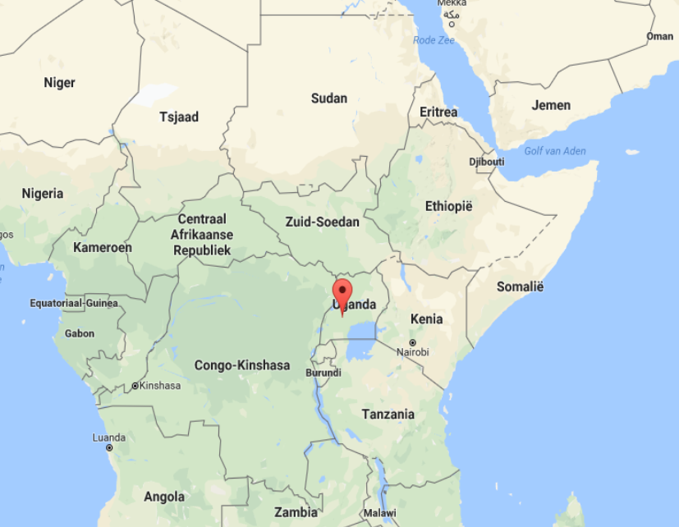
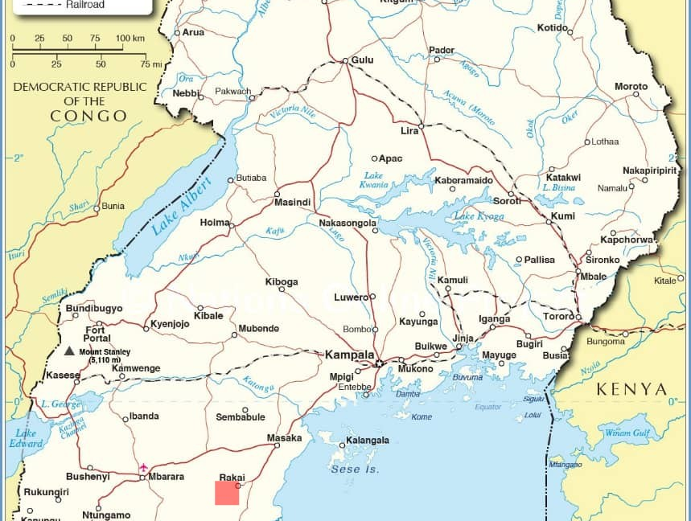
Area and Map Uganda & Kyotera/Rakai
www.childrensolutionministry.comc

Slide 6
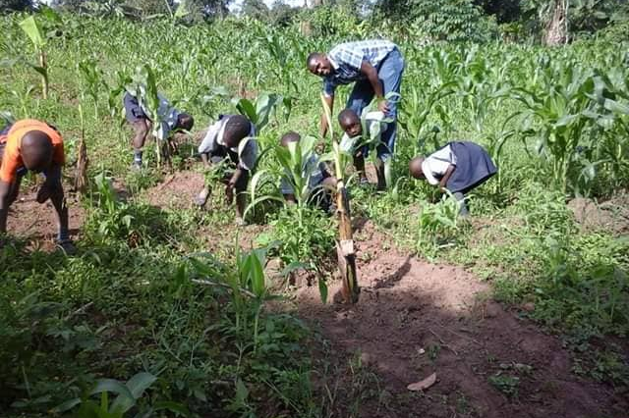
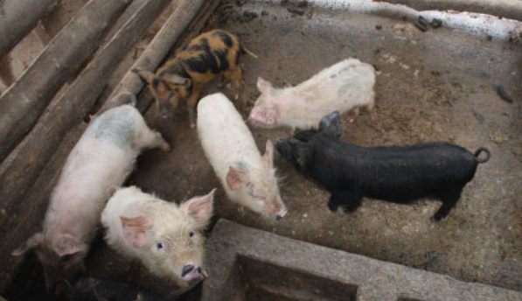
Project activities
Formal education
Music dance and drama
Games and sports
Art and crafts
Farming
Evangelism
www.childrensolutionministry.com

Slide 7
Budget
Item | Description | EUR | Term
More land for farming | 5acres | € 4.255 | Long term
Finishing classrooms | 4 blocks | € 23.759 | Long term
Class room equipment | Tables, Chairs | € 5.822 | Long term
Toilets | Children and staff | € 4.828 | Long term
Kitchen construction | 1 block | € 5.511 | Long term
More kitchen equipment | Pans, dishes, utensils (childres/staff | € 1.426 | Long term
Offices | 1 Administration block | € 13.704 | Long term
Office equipment | Furniture, comp., printer, photocopier | € 3.444 | Long term
Security | Wall fencing | € 8.154 | Long term
Staff quarters | 1 block | € 8.952 | Long term
Teachers' upkeep | 10 teachers per annum | € 855 | 1 Teacher/Year
Water | 4 plastic tanks | € 4.277 | Long term

Slide 8
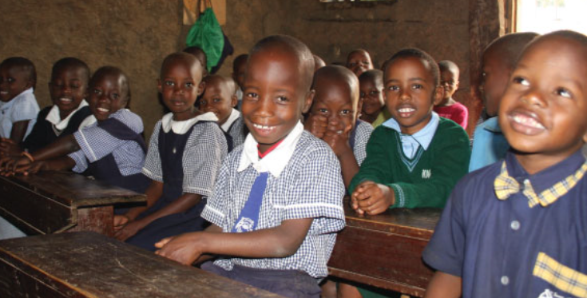

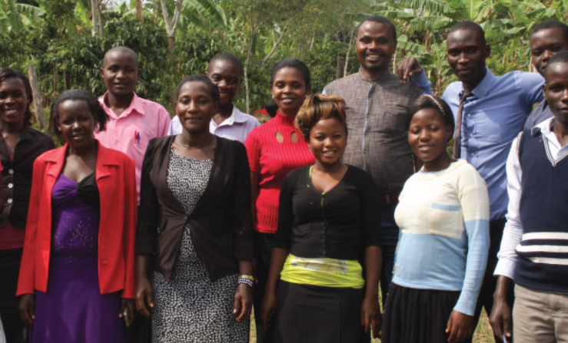
Sponsoring "YOU ARE THE DIFFERENCE IN THEIR LIVES"
For as little as 30€ MONTHLY, you can help keep the dreams of our children alive. Today you can sponsor a child by giving towards their Tuition fees, Meals, Books, Classroom Furniture, Classroom Materials
For as little as 15€ MONTHLY, you can sponsor 10SquareMeters towards acquiring this acrage.
For as little as 20€ MONTHLY, you can sponsor a class by enabling a teacher.
www.childrensolutionministry.com

Slide 9
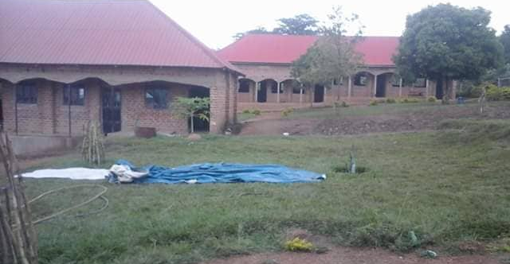
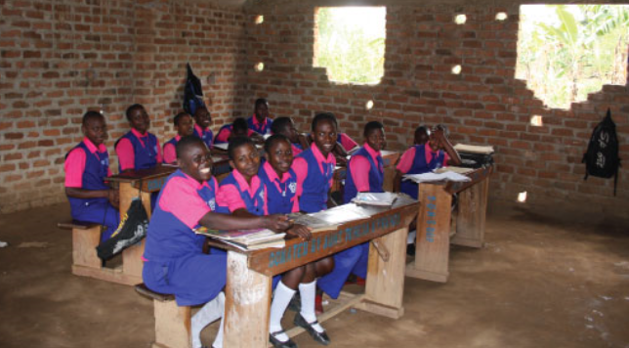
Realised and implemented
Land 2 acres
Some buildings but unfinished
Some furniture
www.childrensolutionministry.com

Slide 10
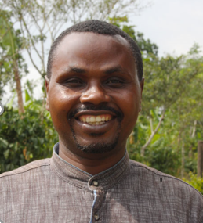
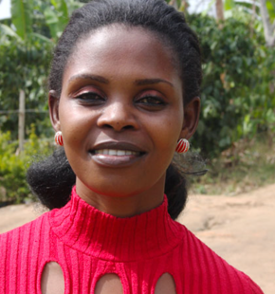
Management of Children’s Solution Ministry
Richard Rukundo is the founding member of the ministry and he serves of the school board as the board chairperson.
Richard together with his wife Harriet founded the Children's Solution Ministry in 2005 after they realized that Rakai district is one of the districts in Uganda which was mostly affected by HIV/AIDS, the killer disease and political wars, leaving most children vulnerable, unprivileged and homeless. Children's Solution Ministry started Solution Academy (A primary school) with students between 3-15 years of age; under a tree shade which was a humble beginning.
His love and passion to bring hope to the unprivileged in his community lead him and his family to start the ministry which he has done full time since inception
Harriet Rukundo is the co-founder and wife to Richard Rukundo with whom they run the organization together.
Apart from being a mother to the 456 students that come through the doors of Children's Solution Ministry, Harriet ensures that the are well fed and ensures the smooth running of the Children's Solution Ministry.
As a musician, she works along side all her husband and organizes the schools music program.
Please see the full team on www.childrensolutionministry.com
www.childrensolutionministry.com

Slide 11
About Children’s Solution Ministry
Children Solutions Mission is a church ministry founded in 2005 to reaching out to vulnerable children in our area of operation. Our calling as a church ministry is to bring hope and love to the little children in Rakai District by empowering them through education and secure their future. CSM is a none profit organization whose vision and mission is to "Physically, mentally and spiritually transformed people." and "To enable the future of vulnerable, unprivileged, needy and orphaned children." Through Donors and Partners, both local and international, We started Solution Academy Primary school in 2005 and Solution Urban High School in 2015. Since then 456Students have joined both Primary and Secondary sections with 356students in Primary section and 100students in the Secondary section and 60students currently in our boarding facilities. Secondary school is on hold for a few years due to limited resources but the intention is to start again when there are enough resources available
The schools are located at Nsambya, Kakoma parish, Rakai District and were the first schools of this kind in a radius of 10kilometer in Rakai District. In the Past years, Rakai District in Uganda was mirred with political unrest, war, HIV AIDS, which leaving most children vulnerable, unprivileged and homeless. More students would love to join this organization but the resources are still limited.
www.childrensolutionministry.com

Slide 12
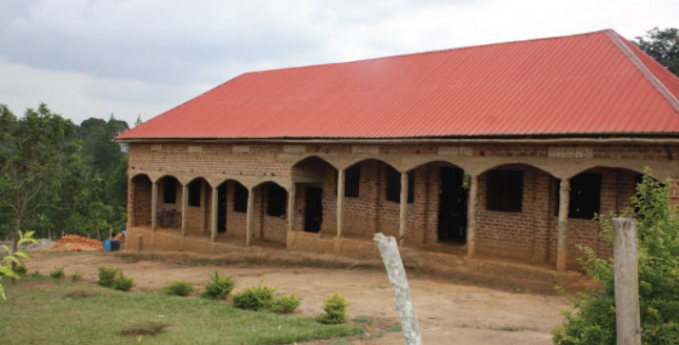
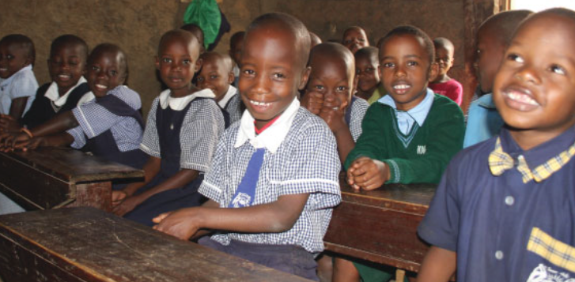
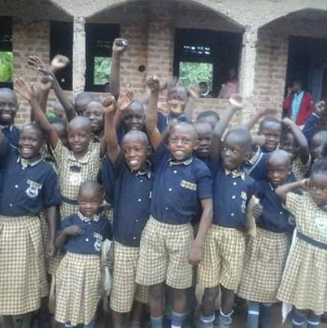
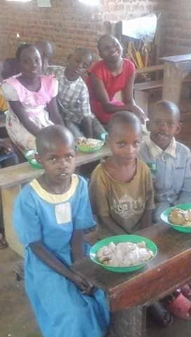
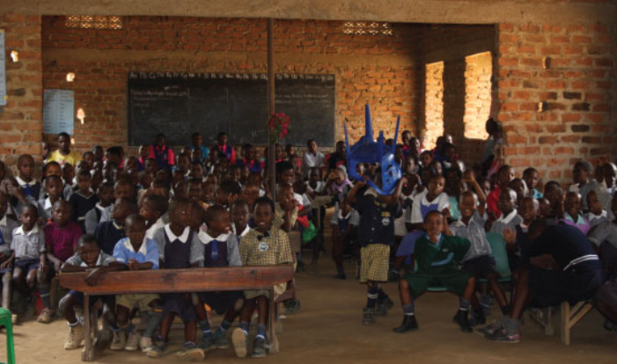
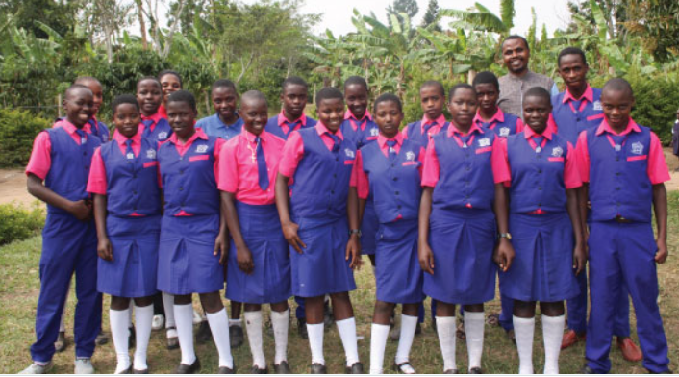
www.childrensolutionministry.com

Slide 13
www.childrensolutionministry.com

